Slide 1
Chapter 01 Fundamental Concepts
Dr. Thanh-Sach LE

Slide 2
Contents
Units of data
bit, byte, word
Number Systems
Memory model

Slide 3
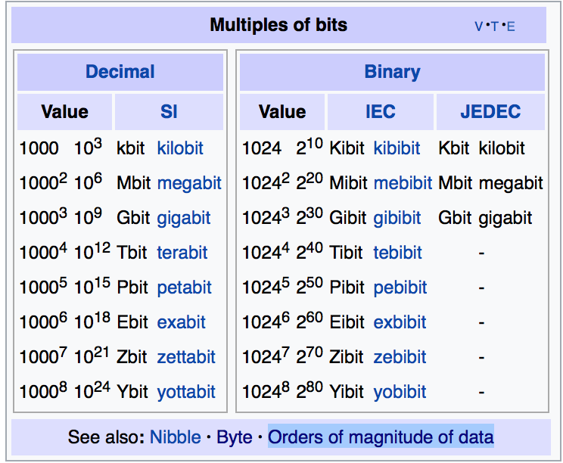
Units of data: bit
A bit
A value that can be either “0” or “1”
N bits
A sequence of N values, each can be either “0” or “1”
Notations
bit
Example: 100 (bits)
b
Example: 100 b
https://en.wikipedia.org/wiki/Bit

Slide 4
Units of data: bit
Related units (1)
bps : bits per second
Number of bits transmitted from A to B per a second
kbps: kilobit per second
…
https://en.wikipedia.org/wiki/Bit

Slide 5
Units of data: bit
Related units (2)
bit is a digit in binary number
Example:
39₁₀ = 00100111₂
8bits length
https://en.wikipedia.org/wiki/Bit

Slide 6
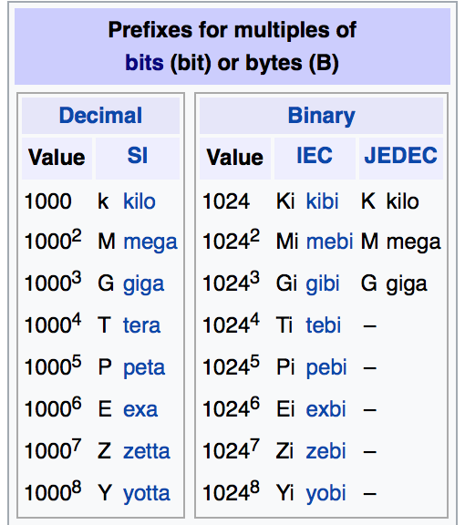
Units of data: byte
Group of N bits.
Popular: N = 8bits
Other cases: from 1 to 48 bits
Notation
B or byte
Example:
Size of “int”: 4B (4 bytes)
Capactiy of a USB: 2GB
Capactity of RAM: 8GB
A HDD: 3TB
https://en.wikipedia.org/wiki/Byte

Slide 7
Units of data: word
Group of N bits that can be handled as a unit CPU
Popular: N = 8, 16, 24, 32, and 64
Modern CPU:
N = 32 (IA-32)
N = 64 (IA-64)
IA-32: “Intel Architecture, 32-bit”
IA-64: “Intel Architecture, 64-bit”

Slide 8
Units of data: word
IA-32: “Intel Architecture, 32-bit”
…
31
1
0
Address register

Slide 9
Number Systems
See:
https://code.tutsplus.com/articles/number-systems-an-introduction-to-binary-hexadecimal-and-more--active-10848
Binary System
Octal System
Decimal System
Hexa System

Slide 10
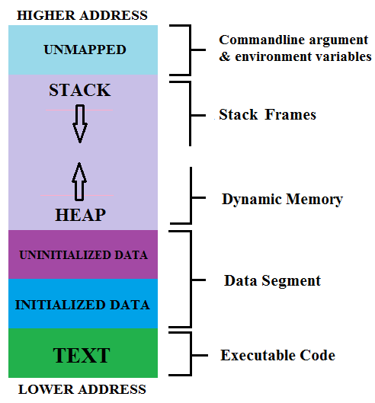
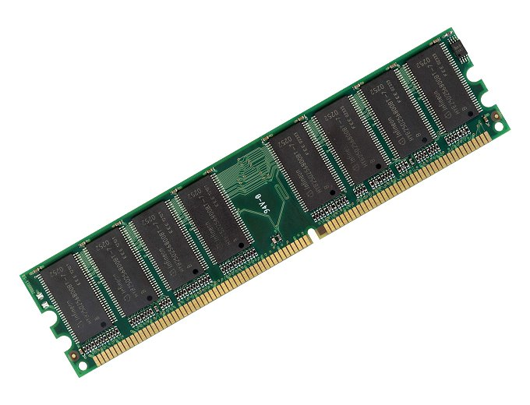
Memory Model
Physical devices
Virtual memory
Virtual address

